Slide 1
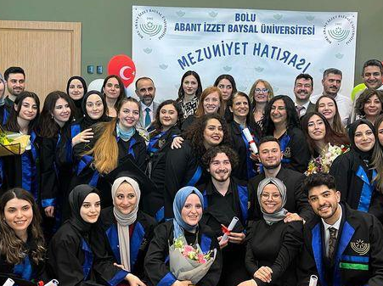

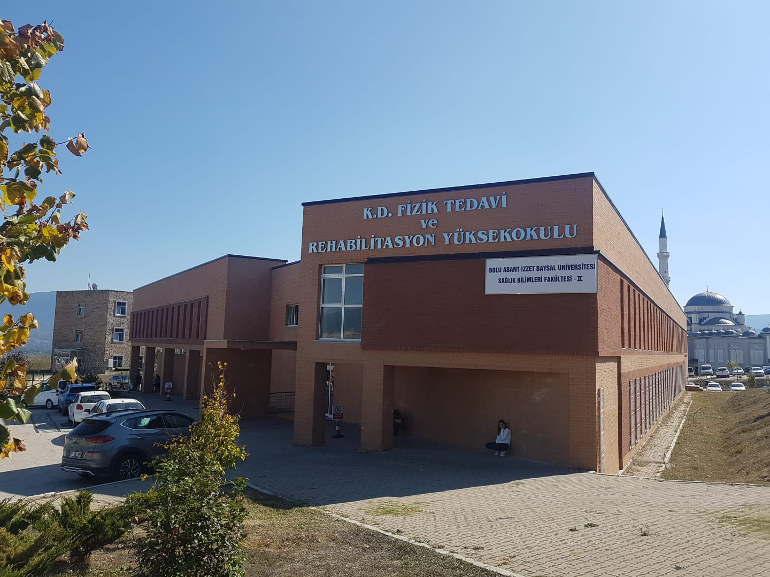
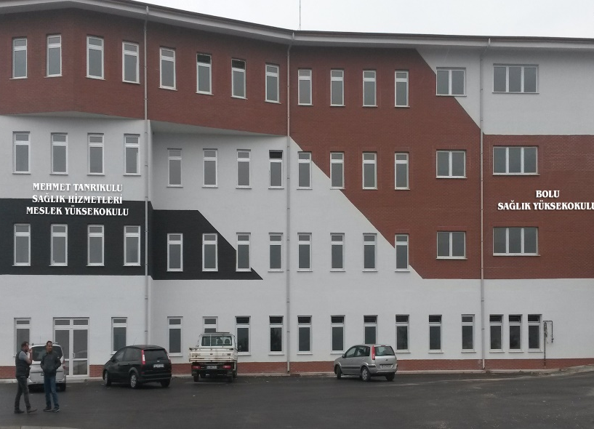
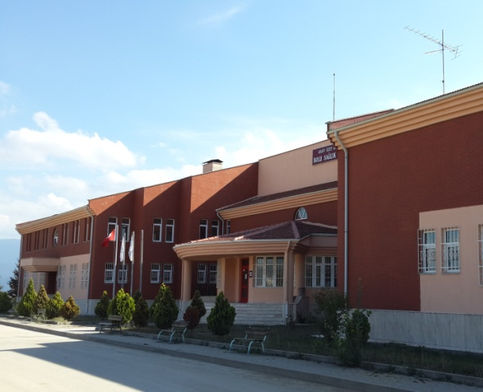
BOLU ABANT IZZET BAYSAL UNIVERSITY
FACULTY OF HEALTH SCIENCES

Slide 2
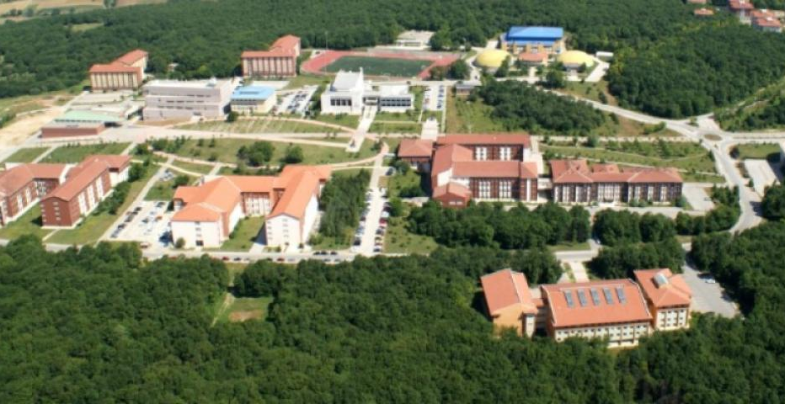
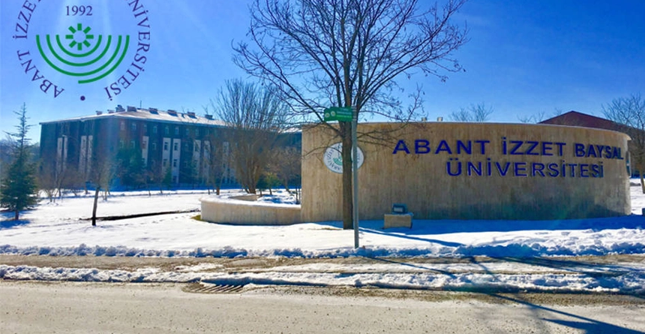
Bolu Abant Izzet Baysal University
Bolu Abant İzzet Baysal University, one of the most distinguished universities of our country, surrounded by natural beauties, was established on July 3, 1992. Our university, which has been developing rapidly since this date, has campuses in Bolu city center and five districts (Gerede, Mengen, Mudurnu, Yeniçağa and Seben). İzzet Baysal Campus, which is the central campus of our university, is located in Gölköy, 8 km from Bolu city center, in a unique natural beauty.
Currently, there are 16 faculties, 1 institute, 1 college, 8 vocational schools and 21 research centers in our university. 1,400+ faculty members and 1,200+ administrative staff working in these units of our university are proud to offer a quality and contemporary education environment to approximately 33,000+ students.
Bolu Abant İzzet Baysal University constitutes a third model as a foundation-supported state university in addition to the state and foundation universities in our country.

Slide 3

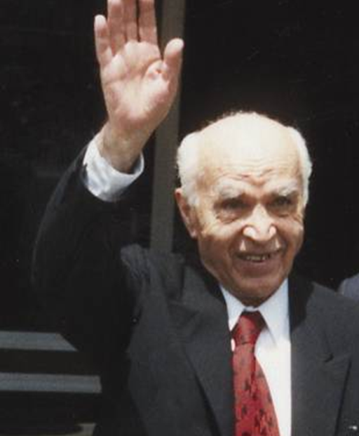
İzzet Baysal (1907-∞)
He was born in Bolu in 1907. He completed his primary and secondary education in Bolu and his higher education as an architect at the Istanbul Academy of Fine Arts.
Baysal, who started his business life as a civil servant, started industrialism by establishing the Temper Casting Factory in 1949. He played a leading role in the development of the foundry industry in Turkey. For years, he was among the top ten people who paid the most income tax in Istanbul.
He founded the İzzet Baysal Foundation, which he calls "my greatest work", in 1987 by allocating it from his tax-paid earnings. İzzet Baysal Foundation has built 141 facilities until 2018.
İzzet Baysal's charitable works range from village health homes to full-fledged hospitals, from mosques to nursing homes, from kindergartens to universities.

Slide 4
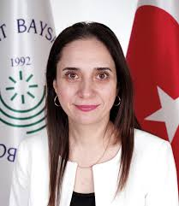
Dear students,
As the Department of Physiotherapy and Rehabilitation, I would like to welcome you together with all our academic and administrative staff and state that we are as happy and excited as you are for your joining us.
Our school started education in 1996 as a college that trains physiotherapists who are experts in the field of physiotherapy and rehabilitation in our country. Our school, which ranks 5th in the list of schools opened in our country, continues its education life as a department of the Faculty of Health Sciences in 2019. At the end of the 2021-2022 Spring semester, we are proud to welcome our 22nd term graduates to their professional lives. We have taken it upon ourselves to provide you with dynamic, innovative and universal standards with our increasing and stronger education staff over the years. The physiotherapist profession, which will provide quality and effective rehabilitation services to our people at all stages of the processes of gaining lost or innate physical abilities, has important duties among all health professionals. Providing quality health care in your professional life requires challenging and high-effort training. In this difficult but enjoyable 4-year period waiting for you, we are ready to provide all kinds of support and to equip you with modern physiotherapy and rehabilitation knowledge and manners. Welcome to our family!
Yours truly.
Prof. Eylem TÜTÜN YÜMİN
Head of Department of Physiotherapy and Rehabilitation

Slide 5
FACULTY MANAGEMENT
Dean
Prof. Dr. Nazmiye KOCAMAN YILDIRIM
Vice Dean
Doç. Dr. Nevin ÇITAK BİLGİN
Faculty Secretary
İbrahim GÜLER

Slide 6

OUR DEPARTMENTS
Disaster and Emergency Aid
Orthotics-Prosthesis
Physiotherapy and Rehabilitation
Nursing
The Faculty of Health Sciences was established on 25.01.2019 with the Presidential Decree No. 669 published in the Official Gazette.
Nutrition and Dietetics
Child Development
Gerontology

Slide 7
STRUCTURING OF THE FACULTY OF HEALTH SCIENCES
DEAN OF FACULTY
Head of the Department of Nursing
Head of the Department of Physiotherapy and Rehabilitation
Nutrition and Dietetics
Head of Department
Department of Pediatric Physiotherapy and Rehabilitation
Department of Geriatric Physiotherapy and Rehabilitation
Department of Neurological Physiotherapy and Rehabilitation
Department of Orthopedic Physiotherapy and Rehabilitation
Department of Cardiopulmonary Physiotherapy and Rehabilitation

Slide 8
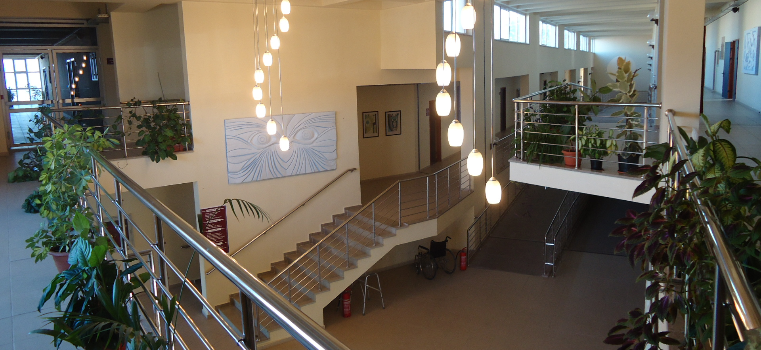

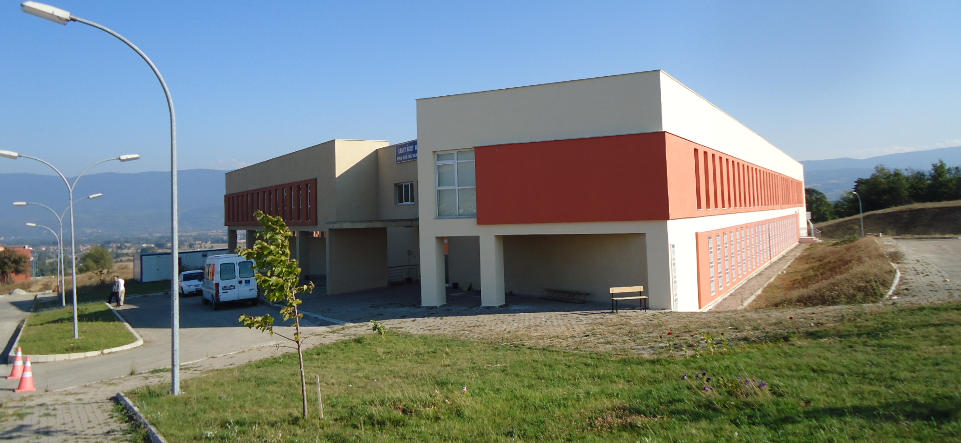
BOLU ABANT IZZET BAYSAL UNIVERSITY
FACULTY OF HEALTH SCIENCES
DEPARTMENT OF PHYSIOTHERAPY AND REHABILITATION

Slide 9
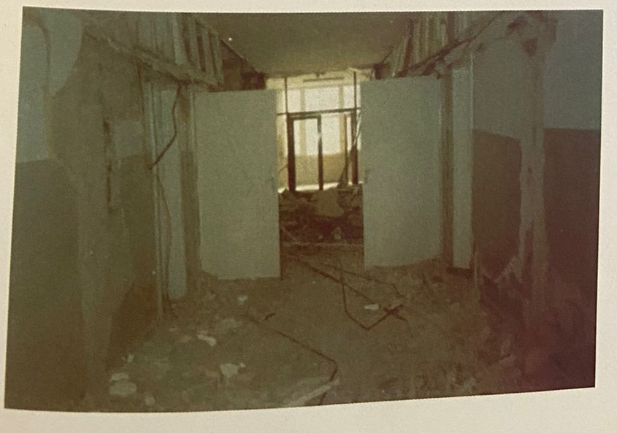
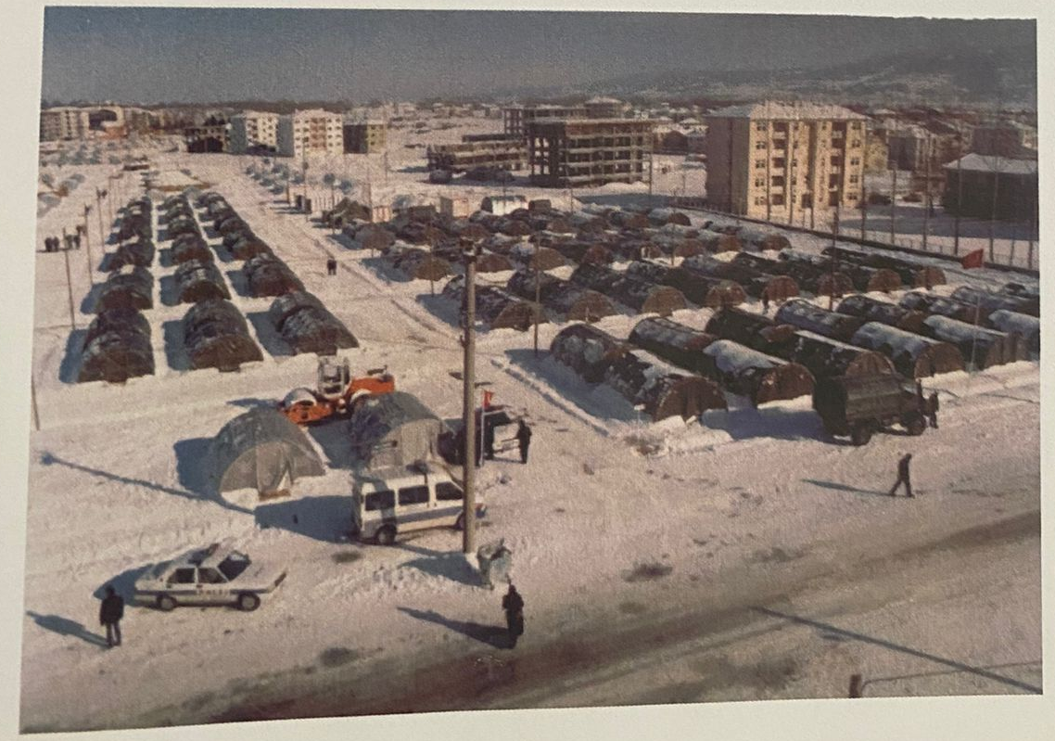
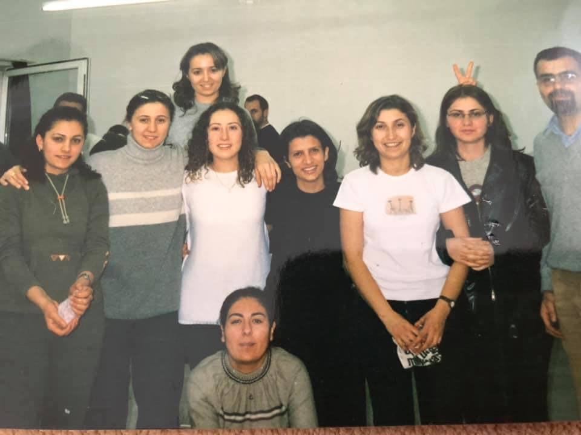
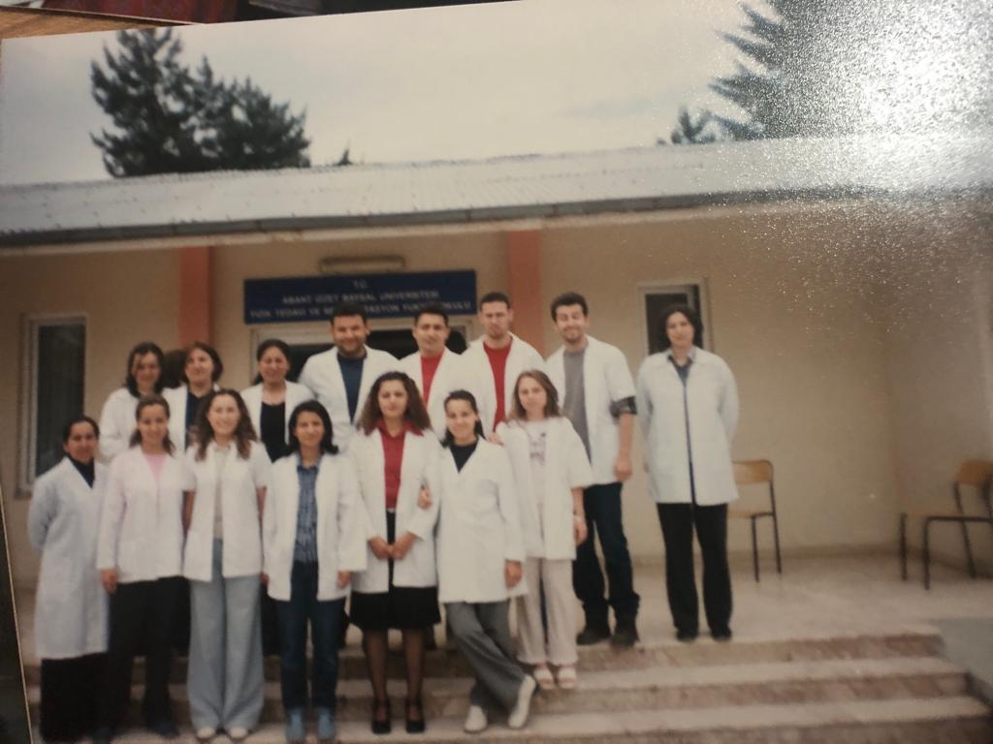
History
On January 19, 1995, it was established as Kemal Demir School of Physical Therapy and Rehabilitation with the decision of the Senate No. 12. It started education with 26 students in the 1996-1997 period and gave its first graduates in 2000.

Slide 10
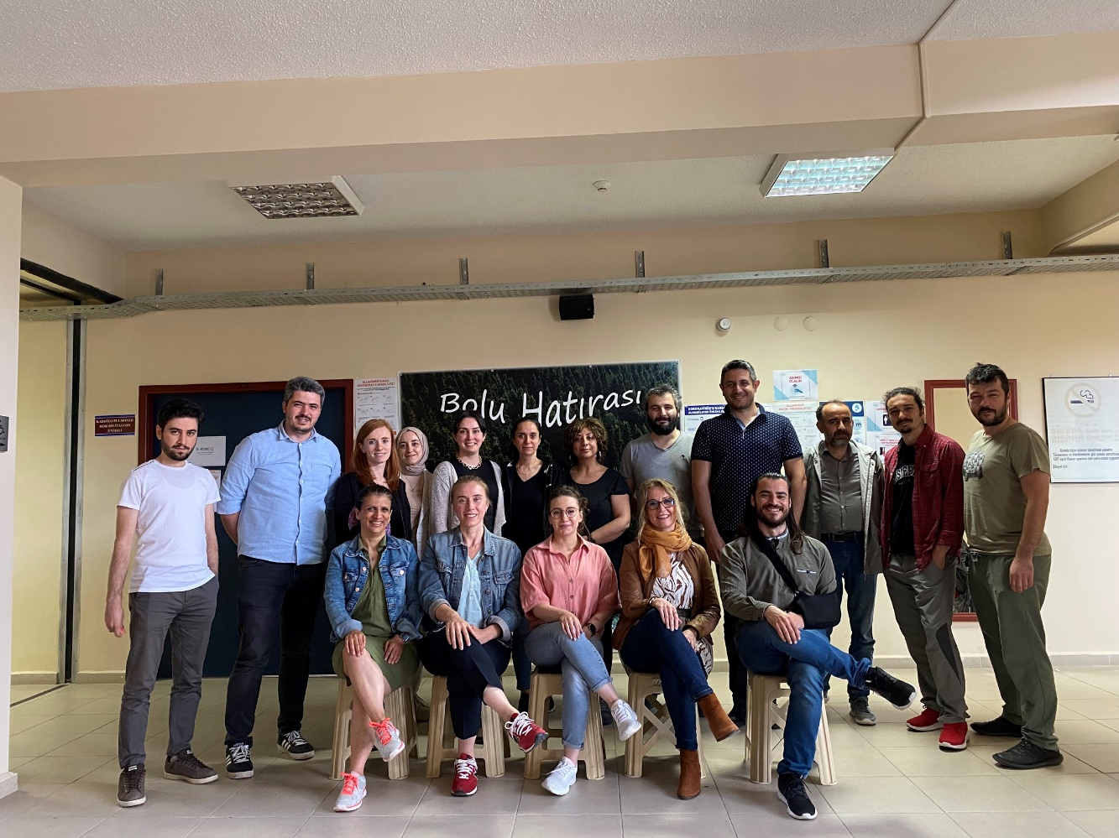
Our school was closed with the decision of the Presidency dated 25.01.2019 and numbered 669 and continues its education as the Faculty of Health Sciences, Department of Physiotherapy and Rehabilitation in the spring semester of the 2018-2019 academic year.

Slide 11

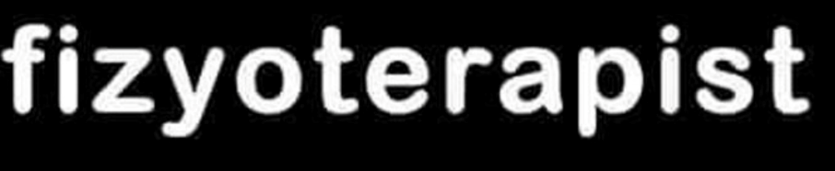
AKADEMİK KADROMUZ
Professor
Prof. Dr. Eylem TÜTÜN YÜMİN
Prof. Dr. Nuriye ÖZENGİN
Prof.Dr. Özlem Çınar Özdemir
Associate Professors
Doç. Dr. Tamer ÇANKAYA
Doç. Dr. Şebnem AVCI
Doç. Dr. Ramazan KURUL
Doç. Dr. Ömer Osman PALA
Assistant Professors
Dr. Öğr. Üyesi Ayşe Neriman NARİN
Dr. Öğr. Üyesi Seda AYAZ TAŞ
Dr. Öğr. Üyesi Sezen TEZCAN
Dr. Öğr. Üyesi. Alp ÖZEL
Dr. Öğr. Üyesi Elif DUYGU YILDIZ
Dr. Öğr. Üyesi Muhammet Fatih UYSAL
Dr. Öğr. Üyesi Enes Tayyip BENLİ
Lecturers
Öğr. Gör. Özlem ÖZER
Öğr. Gör. Serkan SEVİM
Öğr. Gör Tuba KAYA BENLİ
Research Assistants
Arş. Gör. Yasin Devran ALTUNTAŞ
Arş. Gör. Büşra İNAL
Arş. Gör Muhammed Sertaç TUNÇ
Arş. Gör Beyzanur ŞENTÜRK
3 Professors
4 Associate Professors
7 Assistant Professor
3 Lecturers
4 Research Assistants

Slide 12
MISSION
Adhering to Atatürk's principles and reforms,
Having knowledge and application skills in international standards, committed to human rights and ethical values,
Consciously working, contemporary, adopting the principle of lifelong learning, following innovations and literature in the field, high communication and empathy skills,
To train physiotherapists who will keep the memory of İzzet Baysal alive and do justice to his contribution to education and health.

Slide 13

Who is a Physiotherapist?
As stated in the article of the law numbered 6225 in the Official Gazette dated April 26, 2011 and numbered 27916, Physiotherapist; He is a health professional who graduated from faculties or colleges that provide undergraduate education in the field of physiotherapy.
The physiotherapist determines, plans and implements evidence-based protective and developing protocols by making measurements and tests related to his profession in order to regulate the physical activities of people and increase their mobility, except in cases of illness.
In case of disease, it takes into account the diagnosis of the relevant physicians and their guidance for treatment, and makes the necessary applications in order to eliminate or improve the movement and physical dysfunctions of the patients.

Slide 14
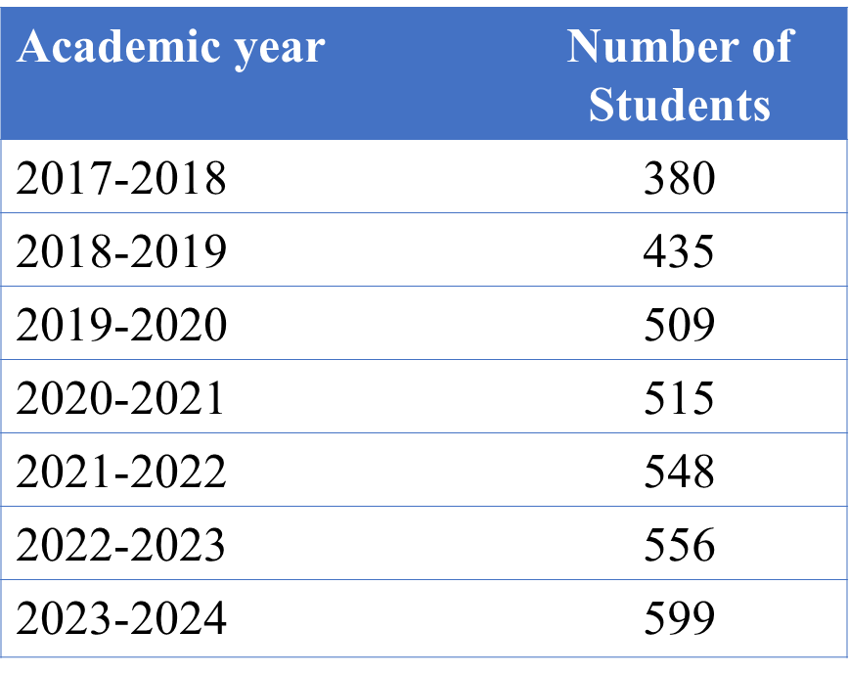

Number of students

Slide 15
OUR EDUCATION
Equipped with the basic knowledge of basic medical sciences such as anatomy and physiology, the student is adapted to the active learning program with case lessons starting from the 1st grade. From this year, general information about the profession, professional law, the duties and responsibilities of the physiotherapist begins to have information.
In the 2nd year, student starts to take courses on professional subjects along with clinical sciences. At the end of the 2nd year, student does his compulsory summer internship in the summer term.
The 3rd grade is a year in which classes for rehabilitation studies begin. Practical and theoretical studies proceed in parallel. At the end of the year, the compulsory summer internship is continued.
In the 4th grade, monthly internships are held in various hospitals in our city and active patients are taken in the presence of a supervisor. During this year, seminars and graduation projects on various subjects are prepared and the student is prepared for graduation.

Slide 16
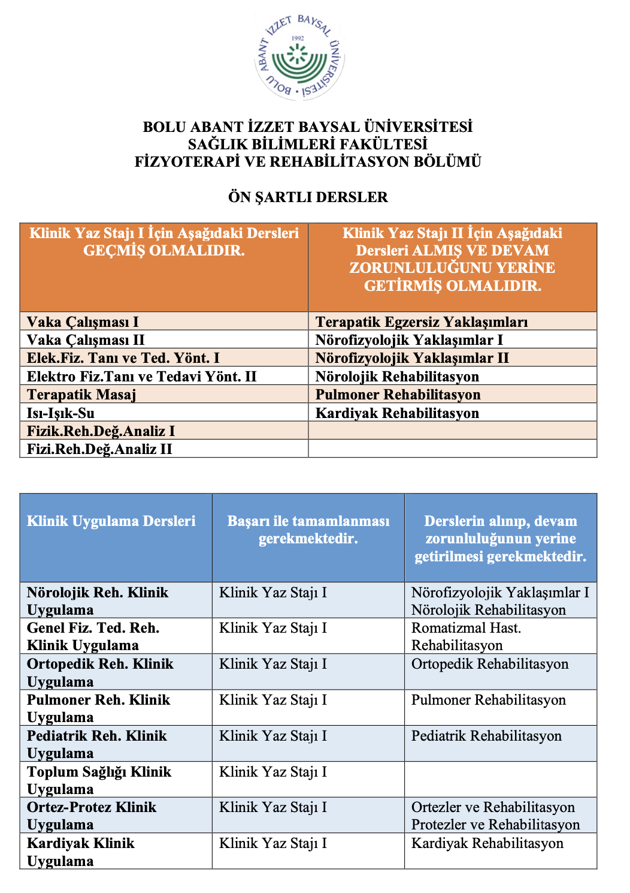
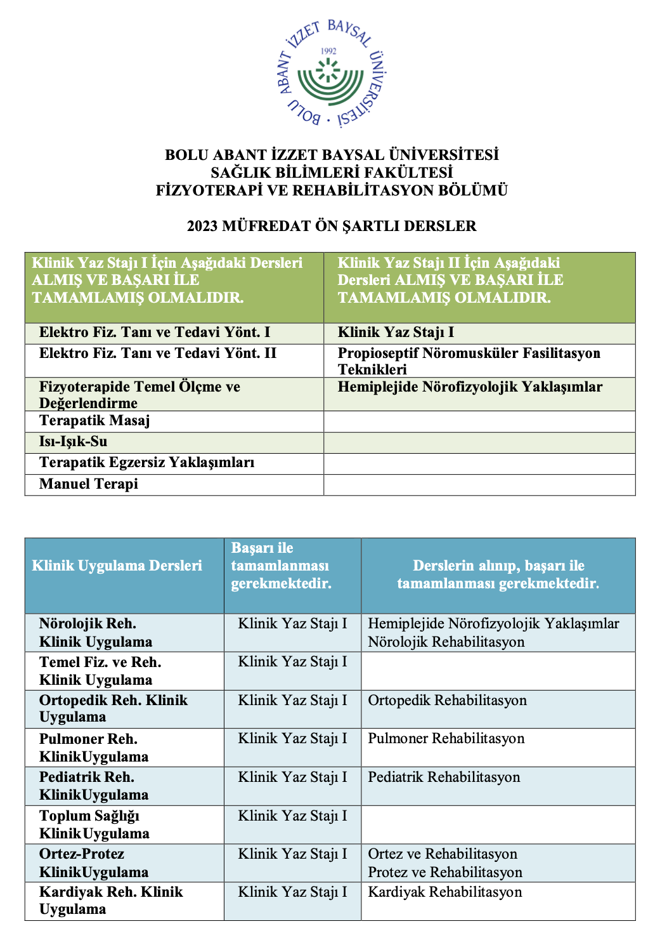

Slide 17
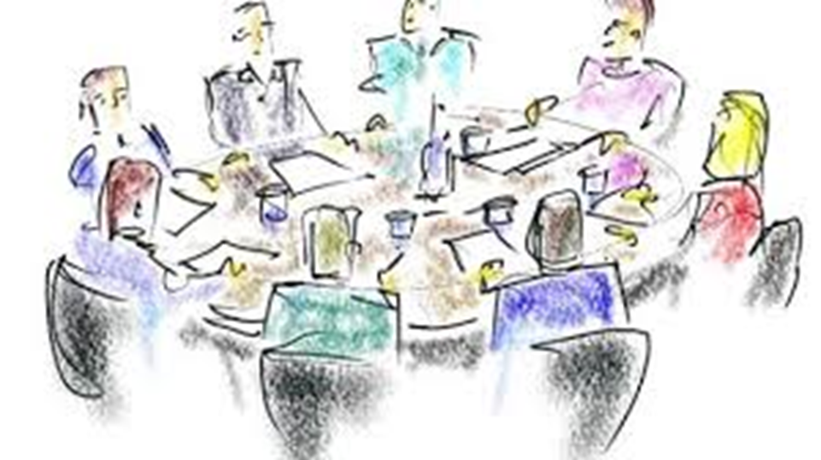
COMMISSIONS
Education Commission
Measurement and Evaluation Commission
Applied Training Commission
Quality and Accreditation Commission
Career and Alumni Monitoring Commission
Overseas Equivalence Commission
Horizontal Transfer, Vertical Transfer and Foreign Student and Adaptation Commission
COORDINATORSHIPS
International Relations Department Coordinatorship

Slide 18


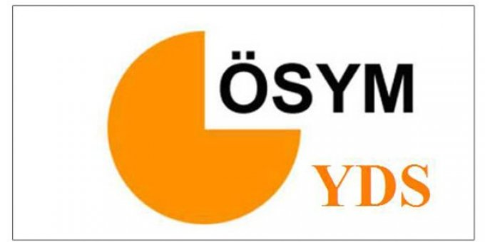
MASTER's and DOCTORATE
Not ortalaması
Individuals who have the GPA requirement determined by the university boards can apply to master's and doctorate programs if they are successful in exams such as ALES, YDS, YÖKDIL. When they get enough points in science and interview exams, they can find the chance to continue their careers as academicians at universities.

Slide 19
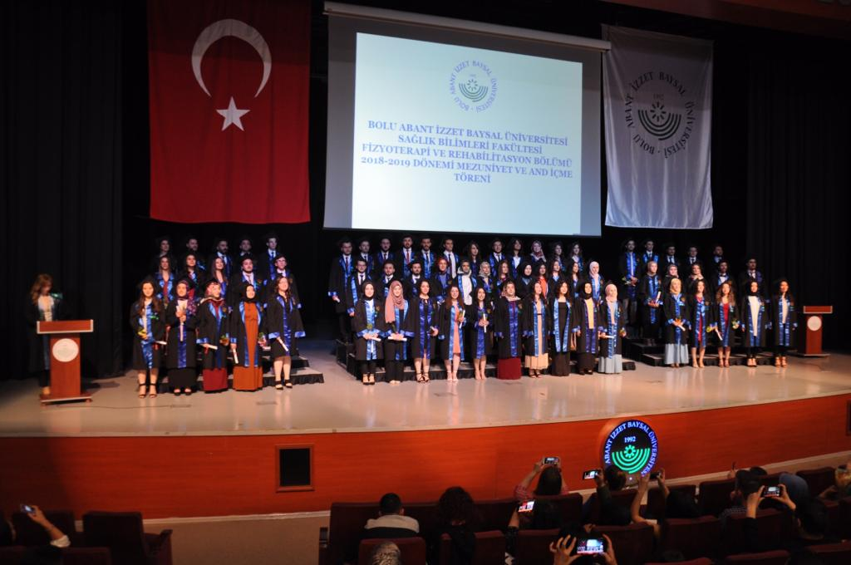
JOB OPPORTUNITIES
Individuals who graduate from our school as physiotherapists have the chance to find jobs in the public and private sectors.
It is possible to work as a lecturer in institutions such as public hospitals, private hospitals, branch centers, gymnasiums, factories and universities.

Slide 20
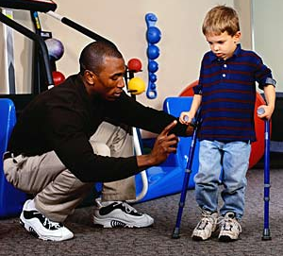
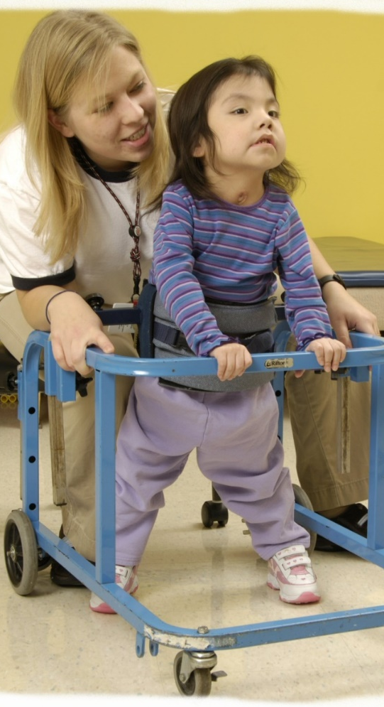
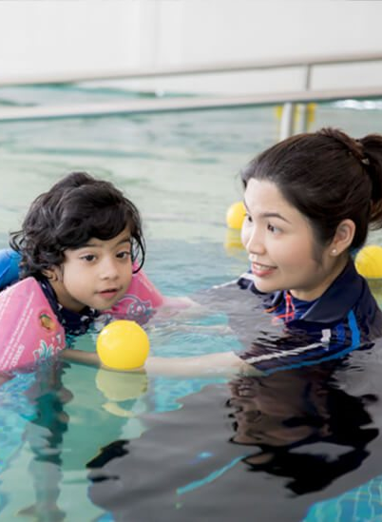
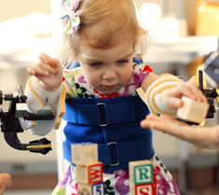
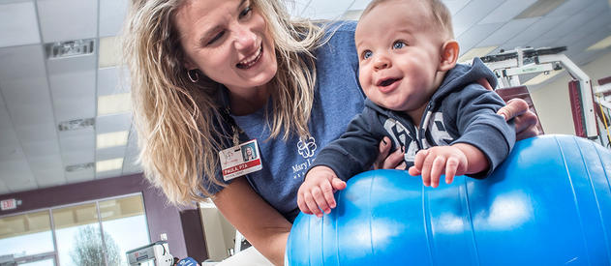

Slide 21

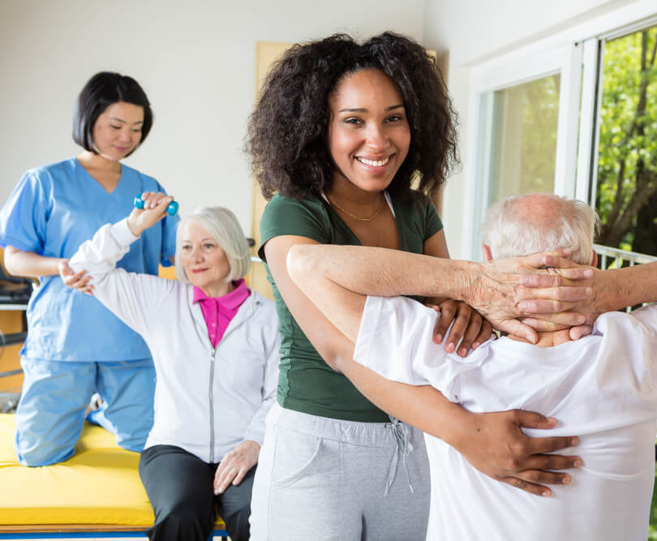
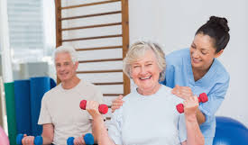
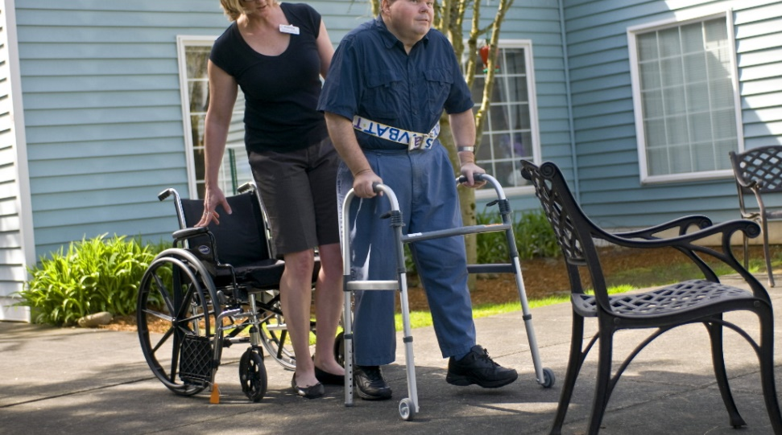

Slide 22
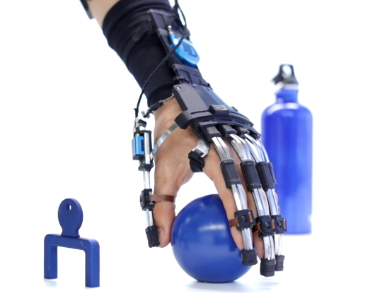
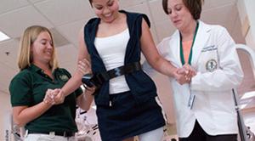
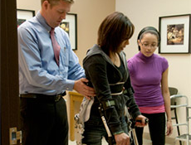

Slide 23
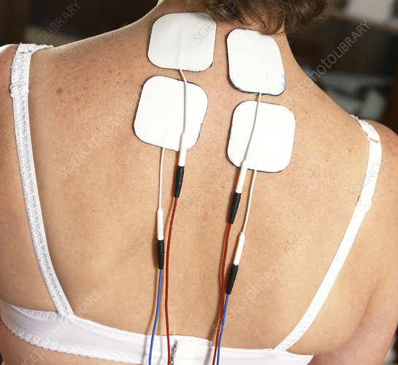
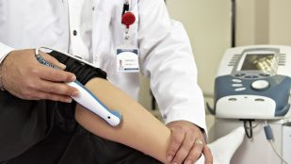
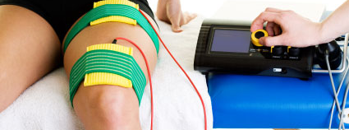

Slide 24
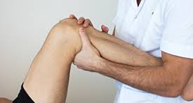
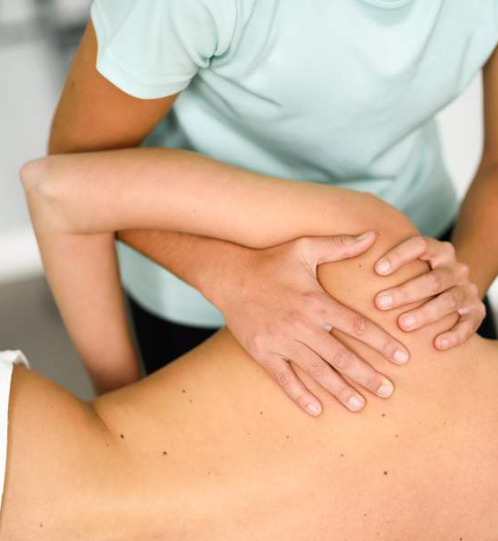
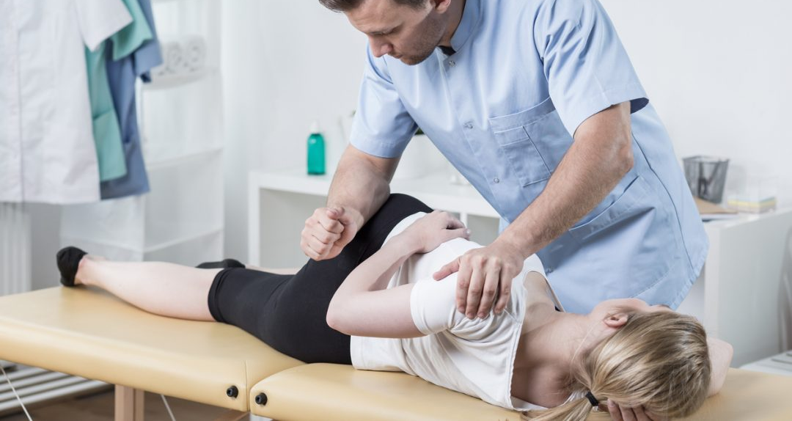

Slide 25
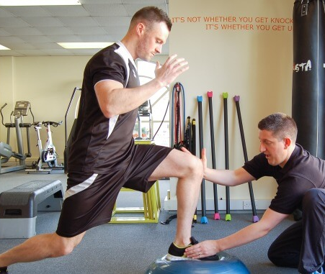
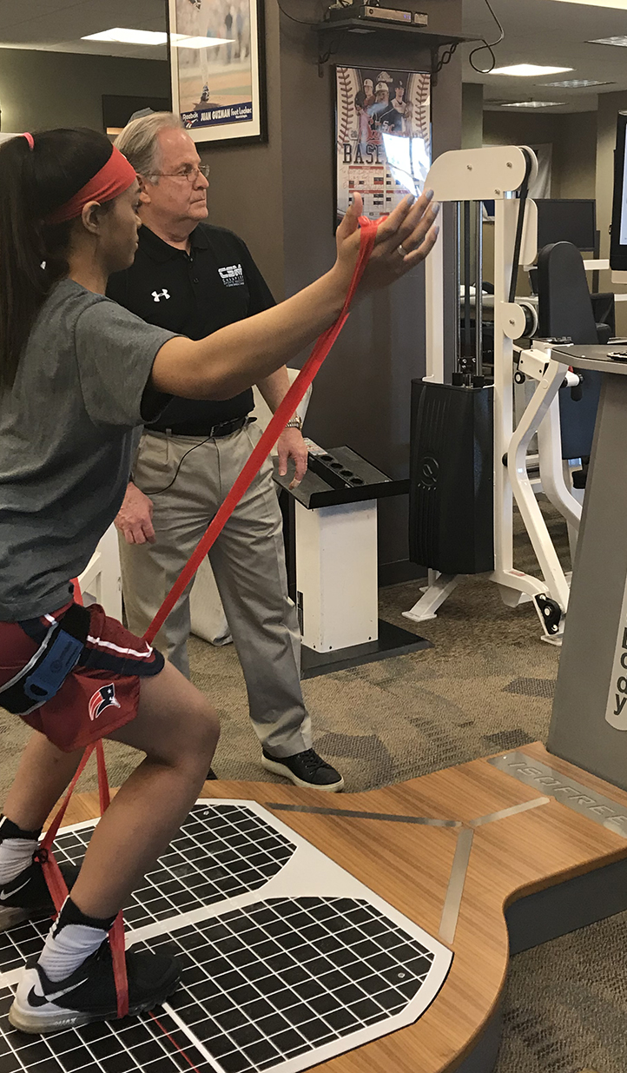
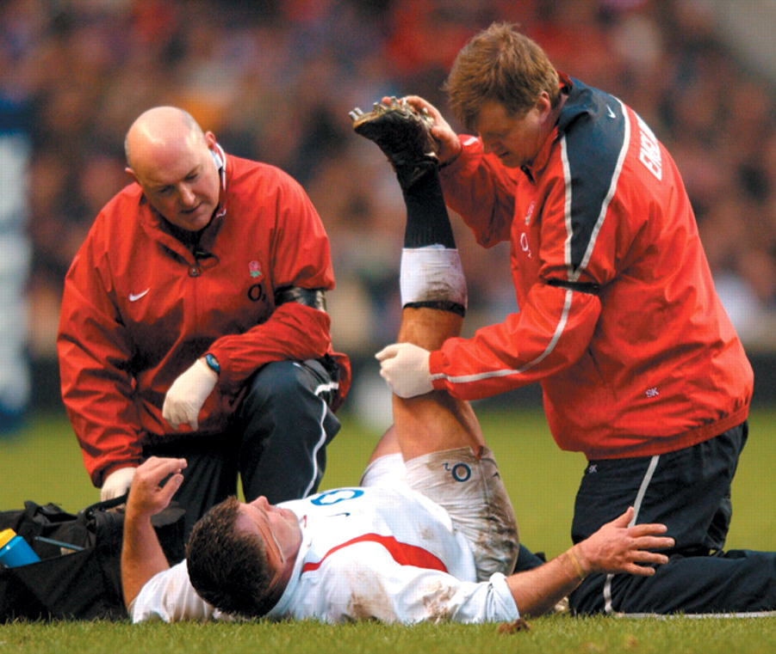
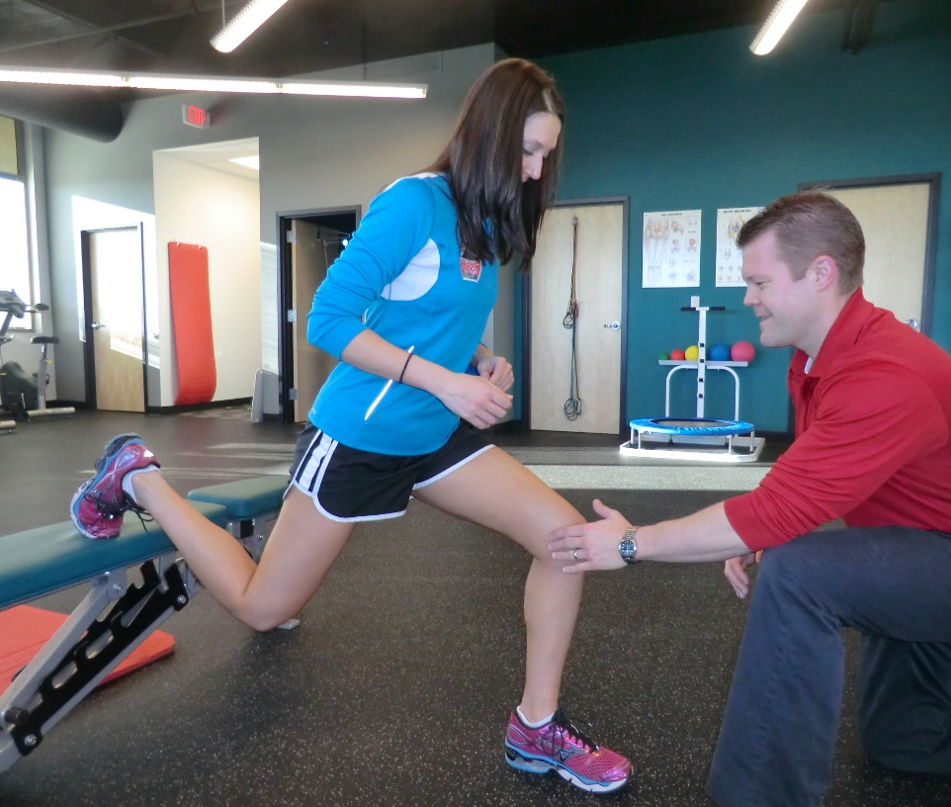
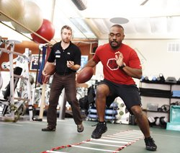

Slide 26
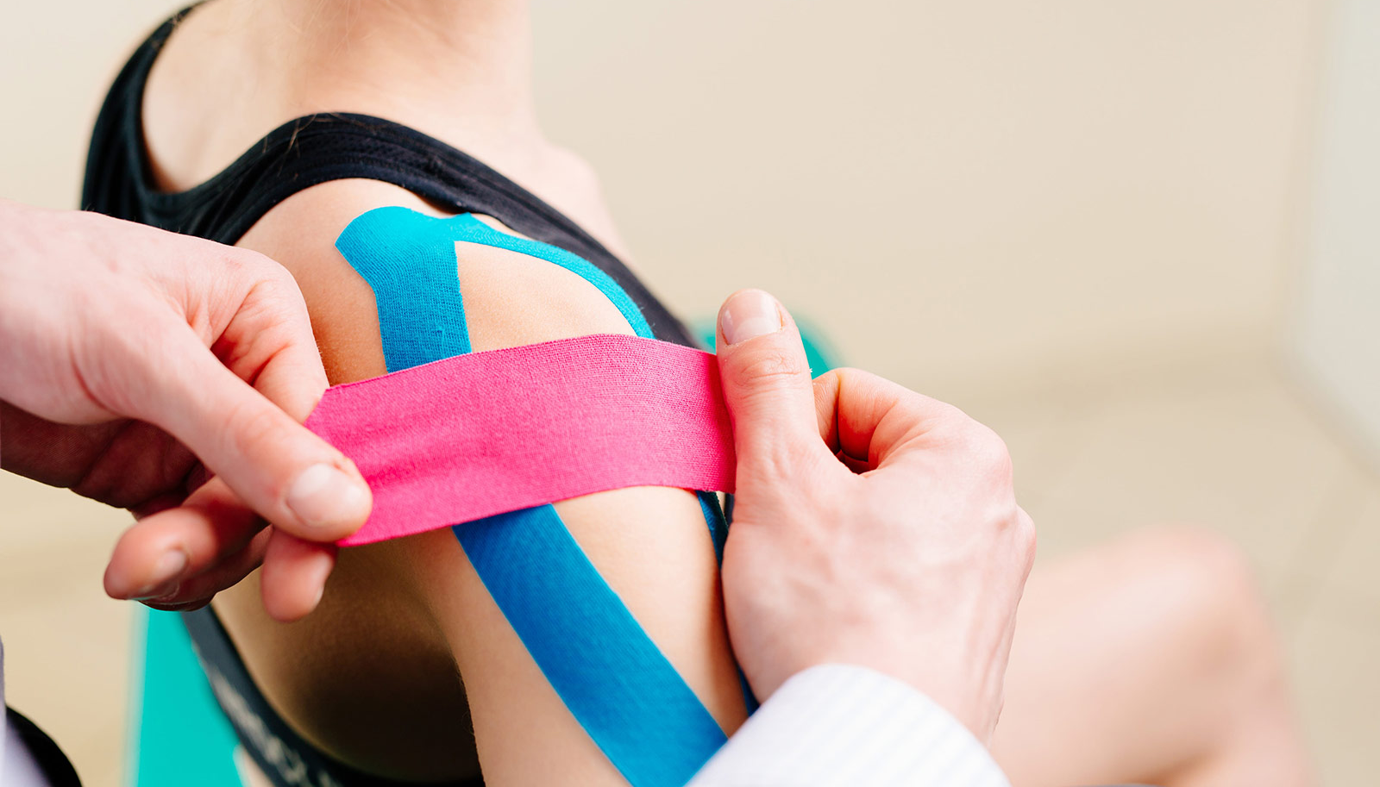
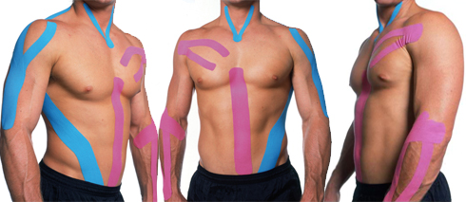
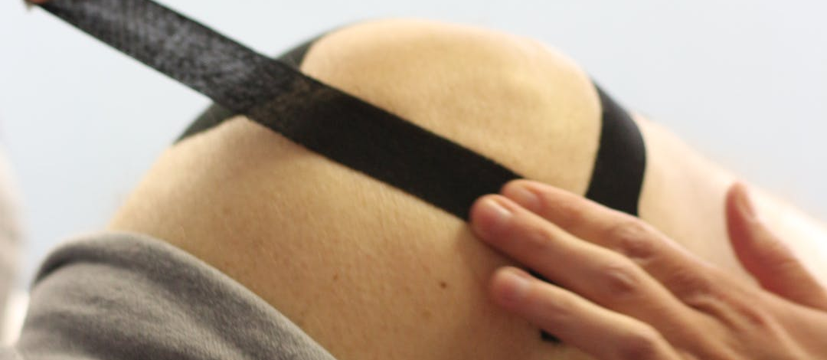
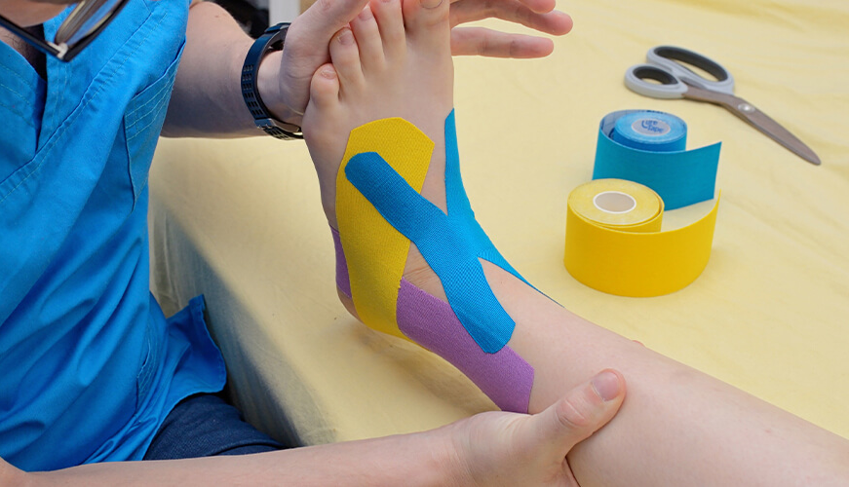

Slide 27
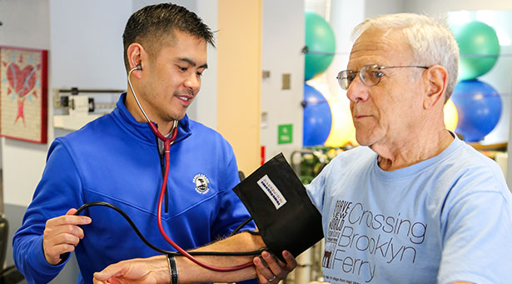
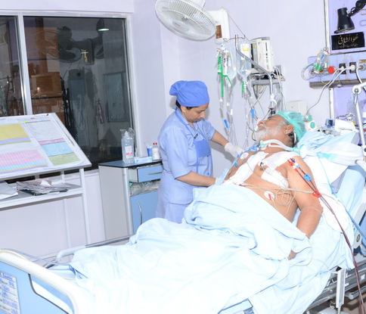


Slide 28





Slide 29





Slide 30





PHYSICAL FACILITIES
Our department continues its educational activities in its own building built on an area of 3000 square meters.
In our building, there is a classroom for each class and practical training units.
There is a canteen and a social activity area for students.
We have a table tennis table.
It is possible to become a member of the FTR community and actively participate in social activities.
As a result of the student representative elections held every year, the student who is entitled to be a representative represents our school in various activities.
It is possible to participate in our sports activities with basketball, volleyball and football teams created for boys and girls.
At the beginning of each fall semester, a 'welcome' party is organized for new students and 'hot-pack' parties are organized for 4th grade students who will leave us in the spring semesters.
In addition to these, picnics, school trips and social activities of our students and teachers are intertwined.

Slide 31


Slide 32


Slide 33




Slide 34


Slide 35


Slide 36


Slide 37

International Exchange Programs
www.erasmus.ibu.edu.tr
It is a semester student exchange program between higher education institutions in Turkey and higher education institutions in Europe.
International Relations and Bologna Faculty Coordinator and Department Coordinator
Assoc. Prof. Dr. Şebnem AVCI

Slide 38



National and International Mobility in Physiotherapy and Rehabilitation
Assoc. Prof. Dr. Şebnem AVCI
International Relations Faculty and FTR Department Coordinator

Slide 39

www.erasmus.ibu.edu.tr

Slide 40


WHO IS ERASMUS?
Desiderius Erasmus (1465-1536) was a Dutch philosopher.
Throughout his life, he lived like a traveler in different countries of Europe; his most important work is "Ode to Madness" (Moriæ Encomium).

Slide 41

WHAT IS ERASMUS+ MOBILITY PROGRAM?
The Erasmus+ Program is a European Union program to encourage higher education institutions to cooperate with each other.
Higher education institutions to produce and implement joint projects with each other; It provides free financial support for short-term student and staff exchanges.

Slide 42
WHAT IS NOT THE ERASMUS+ PROGRAM?
The Erasmus program is not a foreign language learning program, a scholarship program, a diploma program, a research program.

Slide 43
WHAT IS THE PURPOSE OF THE ERASMUS+ PROGRAM?
The aim of the program is to promote and develop cooperation between the European Union countries and the higher education institutions of the candidate countries of the Union and to bring the European dimension to the fore in higher education.

Slide 44
COUNTRY-BASED ACTIVITIES
Erasmus+ Student and Academic Staff Exchange and side activities related to these exchanges are carried out through "national agencies" established in the countries benefiting from the programs.

Slide 45
Which Countries Are Included in the Erasmus+ Program?
- 28 EU member states
- Non-EU programme countries (Norway, Iceland, Liechtenstein, Switzerland, Macedonia and Turkey)
- Third countries (Albania, Bosnia and Herzegovina, Kosovo, Republic of Montenegro, Serbia, Armenia, Azerbaijan, Belarus, Georgia, Moldova, Ukraine, Russian Federation, Algeria, Egypt, Israel, Jordan, Lebanon, Libya, Morocco, Palestine, Syria and Tunisia)
* Partnerships can be established with other countries of the world for some central projects.

Slide 46

GRANT SUPPORTS FOR STUDENT MOBILITY
Group 1 Program Countries
Austria, Denmark, Finland, France, Ireland, Italy, Liechtenstein, Norway, Sweden, Switzerland, United Kingdom
Monthly Student Tuition Grant (€) 500
Monthly Student Internship Grant (€) 600
2. Group Program Countries
Belgium, Croatia, Czech Republic, Cyprus, Germany, Greece, Iceland, Luxembourg, Netherlands, Portugal, Slovenia, Spain, Turkey
Monthly Student Tuition Grant (€) 400
Monthly Student Internship Grant (€) 500
3. Group Program Countries
Bulgaria, Estonia, Hungary, Latvia, Lithuania, Malta, Poland, Romania, Slovakia, Macedonia
Monthly Student Tuition Grant (€) 300
Monthly Student Internship Grant (€) 400

Slide 47
STUDENT MOBILITY
Learning mobility
Internship mobility

Slide 48
Erasmus Application Requirements for Students
1- All full-time students can apply.
Applications are made at http://erasmusbasvuru.ibu.edu.tr/
2- The final transcript grades of associate and undergraduate students who will apply for education and internship mobility must be at least 2.20 out of 4 (the equivalent will be specified in the 100-point system), and 2.50 for master's and doctoral students.

Slide 49

3- Foreign Language Threshold Score, (decided by the Erasmus coordinatorship).
4- Erasmus Student Evaluation Score = 50%*Cumulative Grade Point Average + 50%*Foreign Language Score
5- Education and internship mobility quotas are determined according to the grant amounts to be transferred to our University in the relevant academic year and the schools we have contracted with. The schools we have contracted with and other information and documents related to the program can be found at http://erasmus.ibu.edu.tr/.

Slide 50
Determination of Foreign Language Score
Students who want to benefit from Erasmus Exchange Mobility are required to take the M.Sc. Language Proficiency exams opened by M.Sc. Languages in September/January/June.
Or, a valid document showing the language proficiency score of the last 2 years (AIBU SFL Y. Language Proficiency; YDS/TOEFL, etc., the equivalence of which is accepted by OSYM, must be the final grade of the preparatory class).

Slide 51
Learning Mobility
The activity is the realization of a part of the education of the student enrolled in the higher education institution abroad in the higher education institution that is a partner with an inter-institutional agreement. The duration of the activity can be between 3 and 12 months (1, 2 or 3 semesters according to the systems of some countries) that can be completed in the same academic year, valid for each level of education separately. It is necessary to take courses equivalent to an average of 30 ECTS for each semester.

Slide 52
Internship Mobility
The activity is when a student enrolled in a higher education institution does an internship in an enterprise abroad. An "internship" is the process by which a beneficiary receives vocational training and/or gains work experience within a business or organization in another country participating in the program. Internships can be done for up to 12 months at each academic level, with a minimum of 2 months. Application conditions are announced in advance by the Erasmus Coordination Office.

Slide 53
When do we ship?
We prefer the 4th grade to avoid the extension of the semester.
However, students who do not mind the extension of the semester can participate in mobility from the 2nd grade.

Slide 54

PARTNERS
Czechia
Lithuania
Poland
Macedonia
Romania (two schools)
With the KA107 agreement (within the scope of the project)
Kosava
Jordan
Albania

Slide 55
Duties of the Departmental Erasmus Coordinators
1- Assisting and approving the selected student in filling out the Learning Agreement document.
2- To determine the courses that the student will take abroad and the courses that will correspond to them.

Slide 56
3- To ensure that the selected courses are passed by the faculty/institute/department boards.
4- To approve the course changes made by the student while abroad and to ensure that they are passed by the board.

Slide 57
5- To inform the faculty/institute/department boards for the academic recognition of the courses and grades taken after the student returns.

Slide 58


Slide 59


Slide 60


Slide 61


Slide 62


OUR ACTIVITIES IN THE LAST 5 YEARS
Outgoing students 15
Incoming students 4
Outgoing academic staff 6
Incoming academic staff 9
IT'S YOUR TURN!

Slide 63

FARABI
He was born in 871 in Farab, Turkestan. He traveled to important centers of knowledge such as Bukhara, Baghdad, Damascus, Cairo, Harran and Aleppo. He wrote works in the fields of philosophy, mathematics, logic, political science and music.

Slide 64
The Farabi Exchange Program aims to enable students or faculty members to continue their education and training activities in a higher education institution other than their own institution for one or two semesters.
The principles regarding the implementation of the Farabi Exchange Program are determined in detail by the Regulation and the Principles and Procedures.

Slide 65

RUMI
Mevlana is a famous philosopher who was born in 1207 in the city of Balkh in the province of Khorasan, which was within the borders of today's Afghanistan, Iran at that time.
Mesnevî, which he wrote in Konya, is accepted as one of the greatest poems written in the Persian language.

Slide 66
Unlike other exchange programs, mobility within the exchange program covers higher education institutions all over the world, regardless of geographical region.

Slide 67

Twitter: @shebnemavci
e-posta: avci_s@ibu.edu.tr

Slide 68
ACTIVITIES

Slide 69

Faculty of Health Sciences Girls' Basketball Team won the 3rd place cup and medal.
Our Girls' Basketball Team brought a medal from the first tournament it participated in.

Slide 70



Slide 71




Slide 72



Slide 73


Slide 74



Various Congresses, Symposiums and Panels

Slide 75



Slide 76











Slide 77



Slide 78



Slide 79


Slide 80



Slide 81




Slide 82
Graduation

Slide 83


Slide 84



Slide 85

YOU CAN FOLLOW US HERE ☺
https://sbf.ibu.edu.tr
😉

Slide 86

Department Website

Slide 87

You can do your operations such as choosing courses, viewing notes, etc. from bys.ibu.edu.tr or here.
With the student e-mail address assigned to you, you can scan and borrow books from the library page

Slide 88

Instagram

Slide 89

Twitter

Slide 90



BAIBU Physical Therapy and Rehabilitation Society
Founded: 1998
Head of the Community
Yaren HIMMET
Community Academic Advisor
Prof.Dr. Nuriye ÖZENGİN

Slide 91
Ten Golden Advice from İzzet Baysal
Take time to think, thought is the source of power.
Take time to have fun, fun is the secret of youth.
Take the time to read, reading is the fountain of knowledge.
Take time to pray, prayer is the support of perseverance in difficult moments.
Take the time to love, loving is what makes life sweet.
Take your time with the agreement, the agreement gives a good taste of life.
Take time to laugh, laughter is the beauty of the soul.
Take the time to give, giving is the light of the day.
Take the time to do your job well, good work makes a person respectable.
Take the time to say thank you, thanks are the icing on the cake of life.

Slide 92
IN THE NEW ACADEMIC YEAR
WE WISH SUCCESS TO ALL OUR STUDENTS.
FTR Instructors

